Slide 1
Predicting Household Income vs Expenditures
Week 3
The Topic: Household incomes and expenditures. The reason why we picked this topic was due to the fact that today’s economy is crazy, and we want to see if we can predict how bad (or good) the economy will get in the next year.
Questions we hope to answer with Data:
What will the economy look like in one year?
Will the income and the expenditures both increase?
Will the data reflect what the economy will look like?
Description of the data phase of the project:
Data was found on a government website, under the topic "Economy". Link:https://www.stats.govt.nz/large-datasets/csv-files-for-download/#:~:text=CSV%20files%20are%20text%20files%20with%20information%20separated,Microsoft%20Excel%2C%20the%20R%20statistical%20environment%2C%20or%20Python. This data includes household income, and expenditures such as rent, gas, bills etc.

Slide 2
Description of the analysis phase of the project:
The dataset contained expenditures and income from 2008-2022
We extracted a four year range from 2019 to 2022
Using 2019- 2021 to predict the 2022 expenditures and income
Our goal is to see how accurate our model predicted 2022

Slide 3
Technology tool and algorithms used of the project:
Excel for viewing the initial data
Pandas/Python for cleaning the data and transforming
Machine Learning we used the LSTM Regression Model
SQL for building our database and creating additional csv files
Tableau for visualization

Slide 4
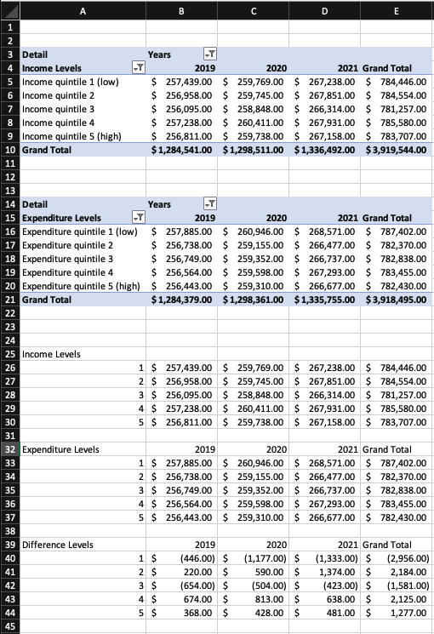
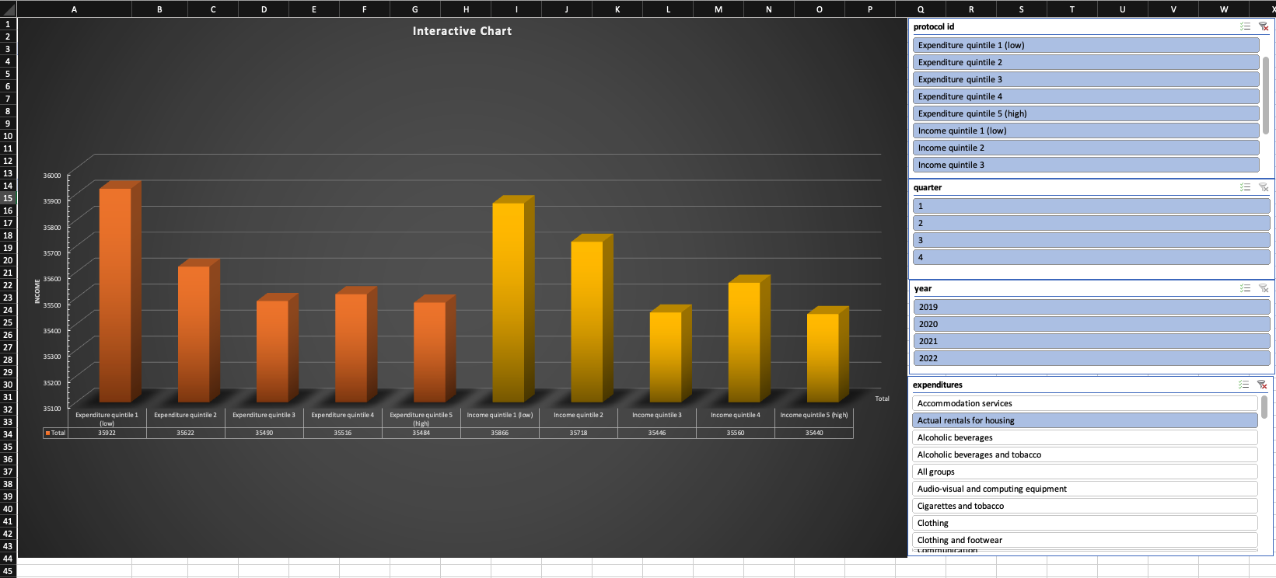
Technology tool and algorithms used of the project:
Excel for viewing the initial data

Slide 5
Technology tool and algorithms used of the project:
Pandas/Python for cleaning the data and transforming

Slide 6
Technology tool and algorithms used of the project:
Machine Learning we used the LSTM Regression Model

Slide 7
The results

Slide 8
Any recommended future analysis
Anything done differently

Slide 9
Anything done differently

